Slide 1
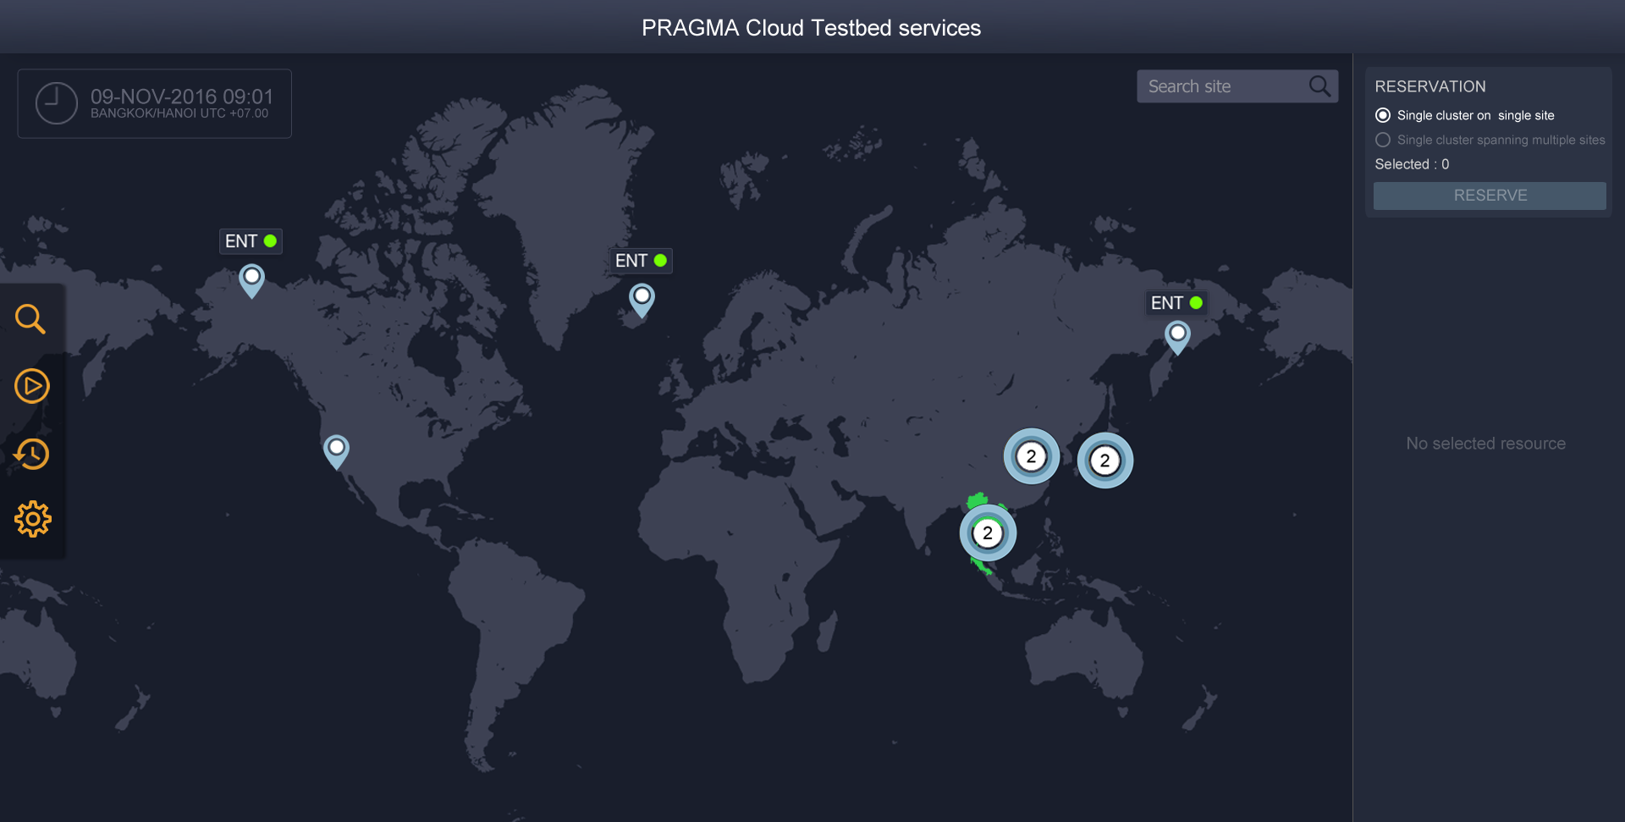
Notes:
Test

Slide 2
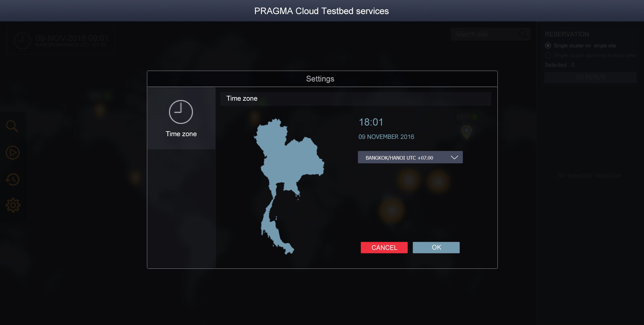
Notes:
Test

Slide 3
Notes:
Test

Slide 4
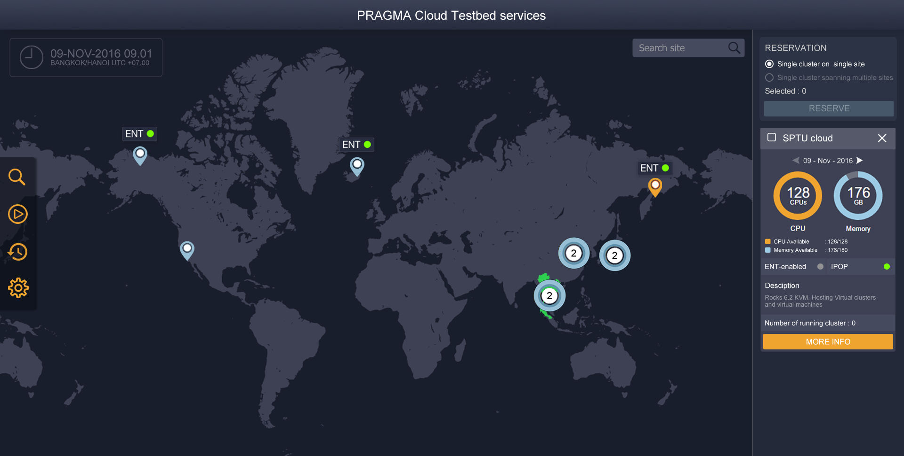
Notes:
Test

Slide 5
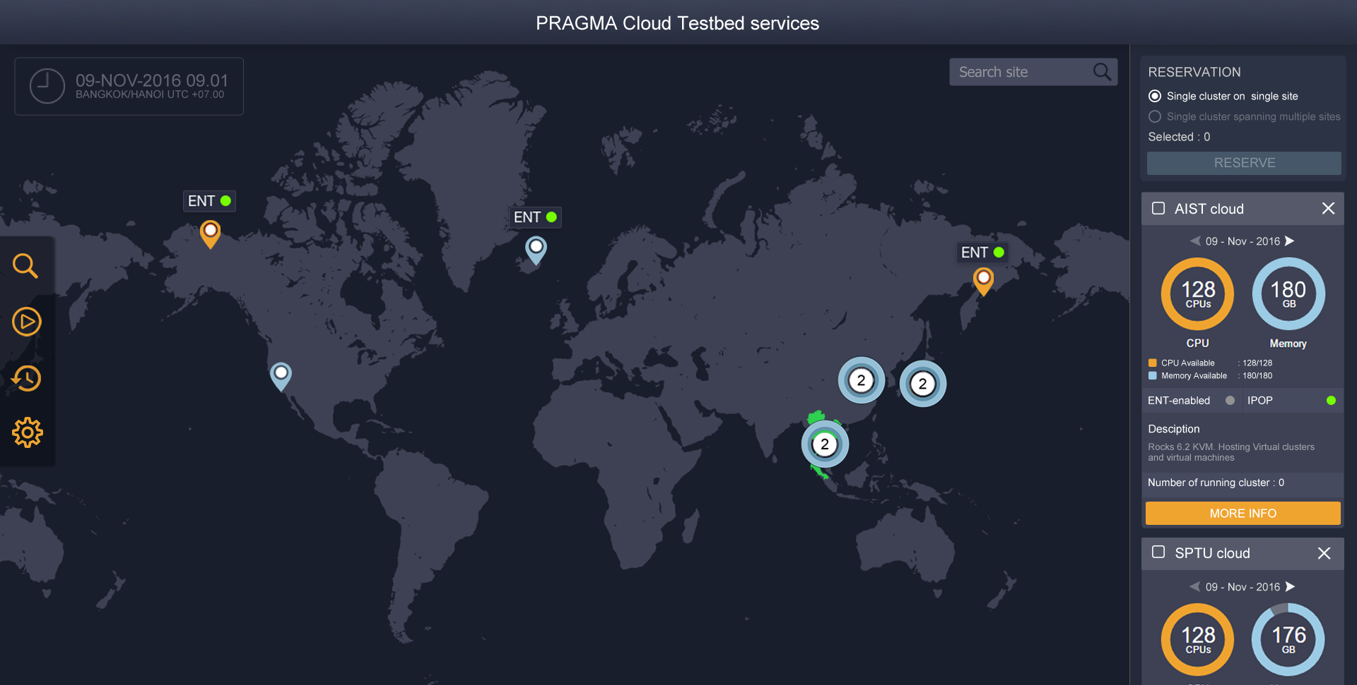
Notes:
Test

Slide 6
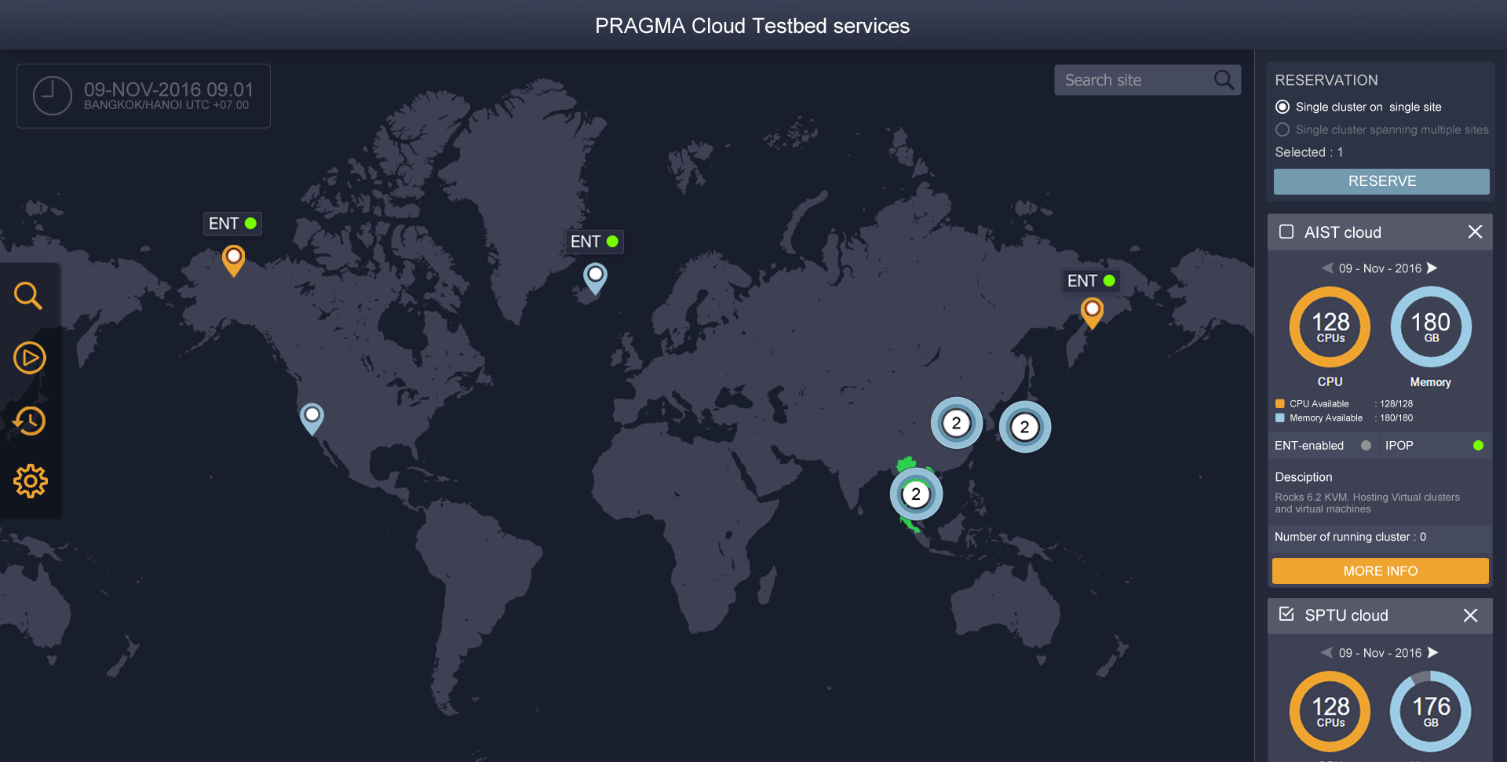
Notes:
Test

Slide 7
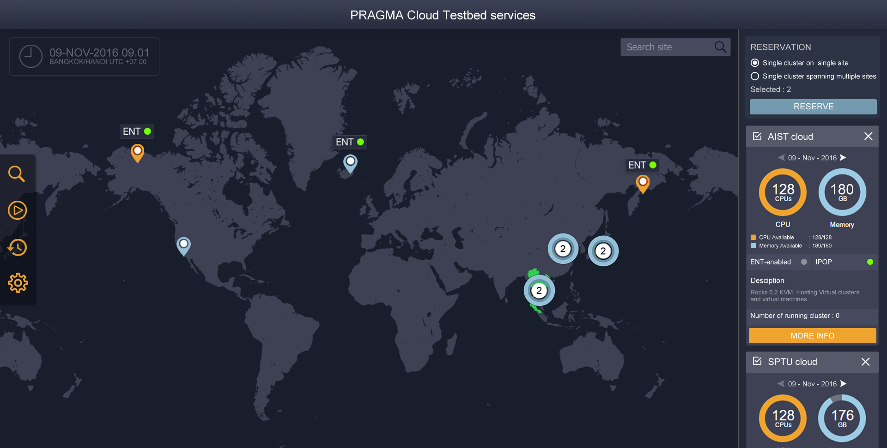
Notes:
Test

Slide 8
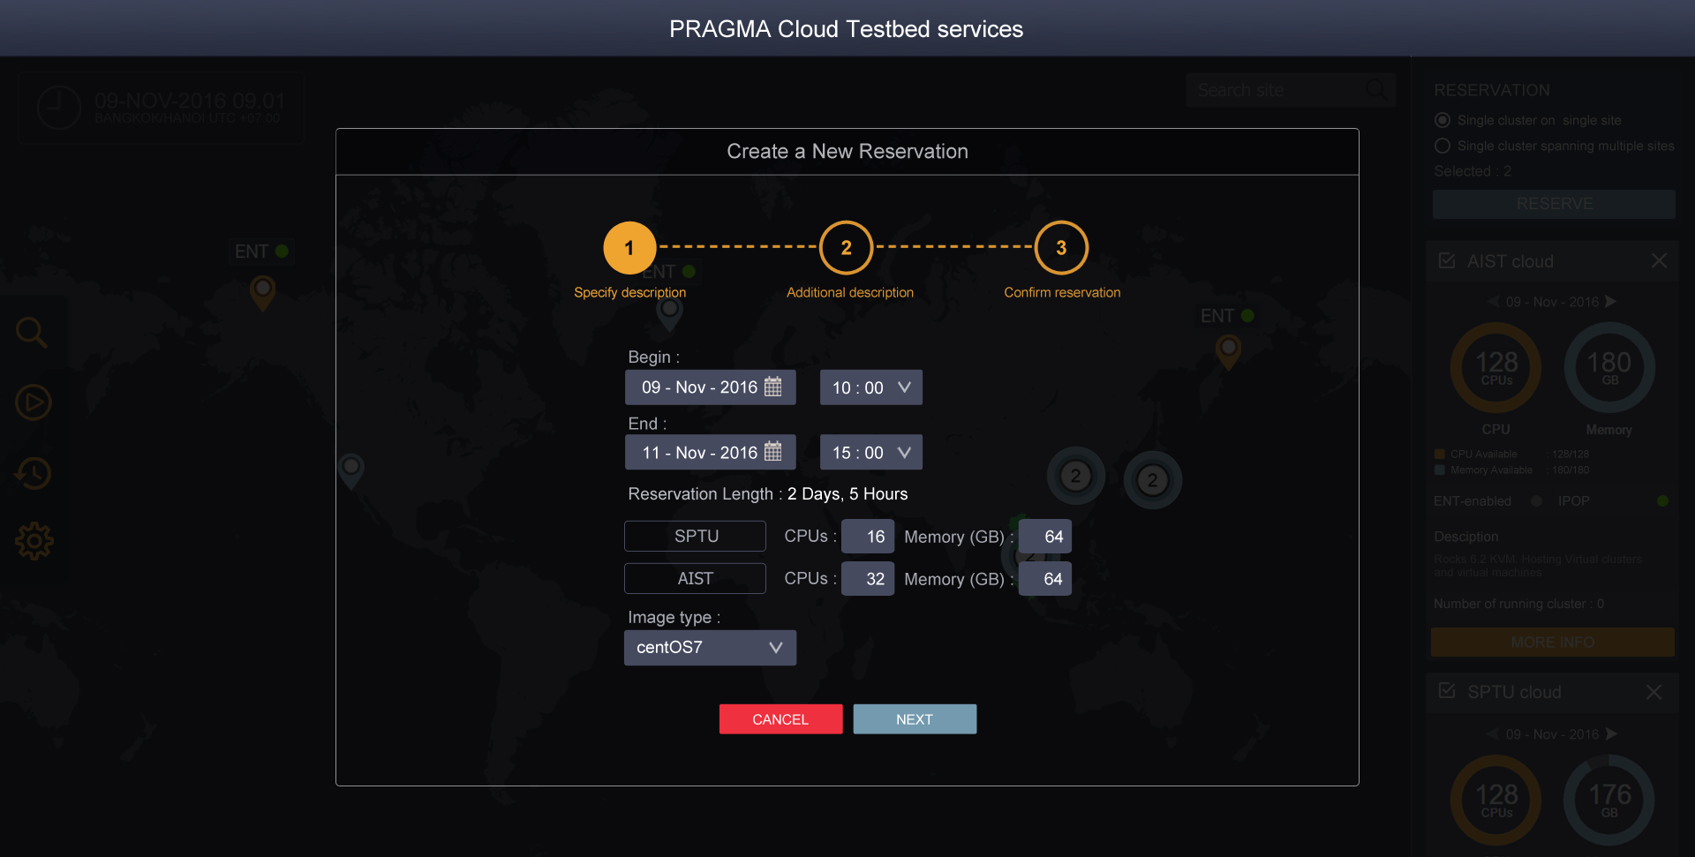
Notes:
Test

Slide 9
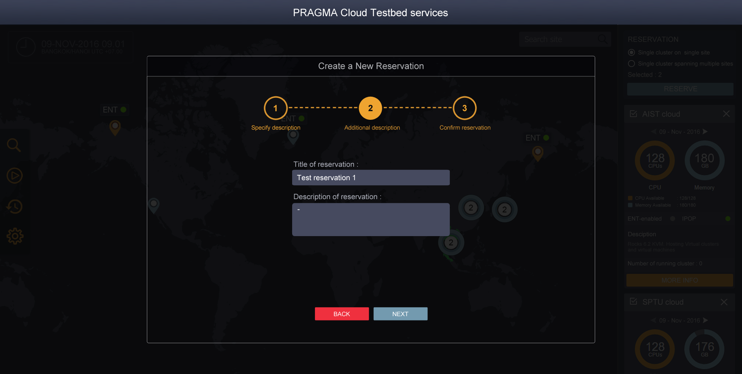
Notes:
Test

Slide 10
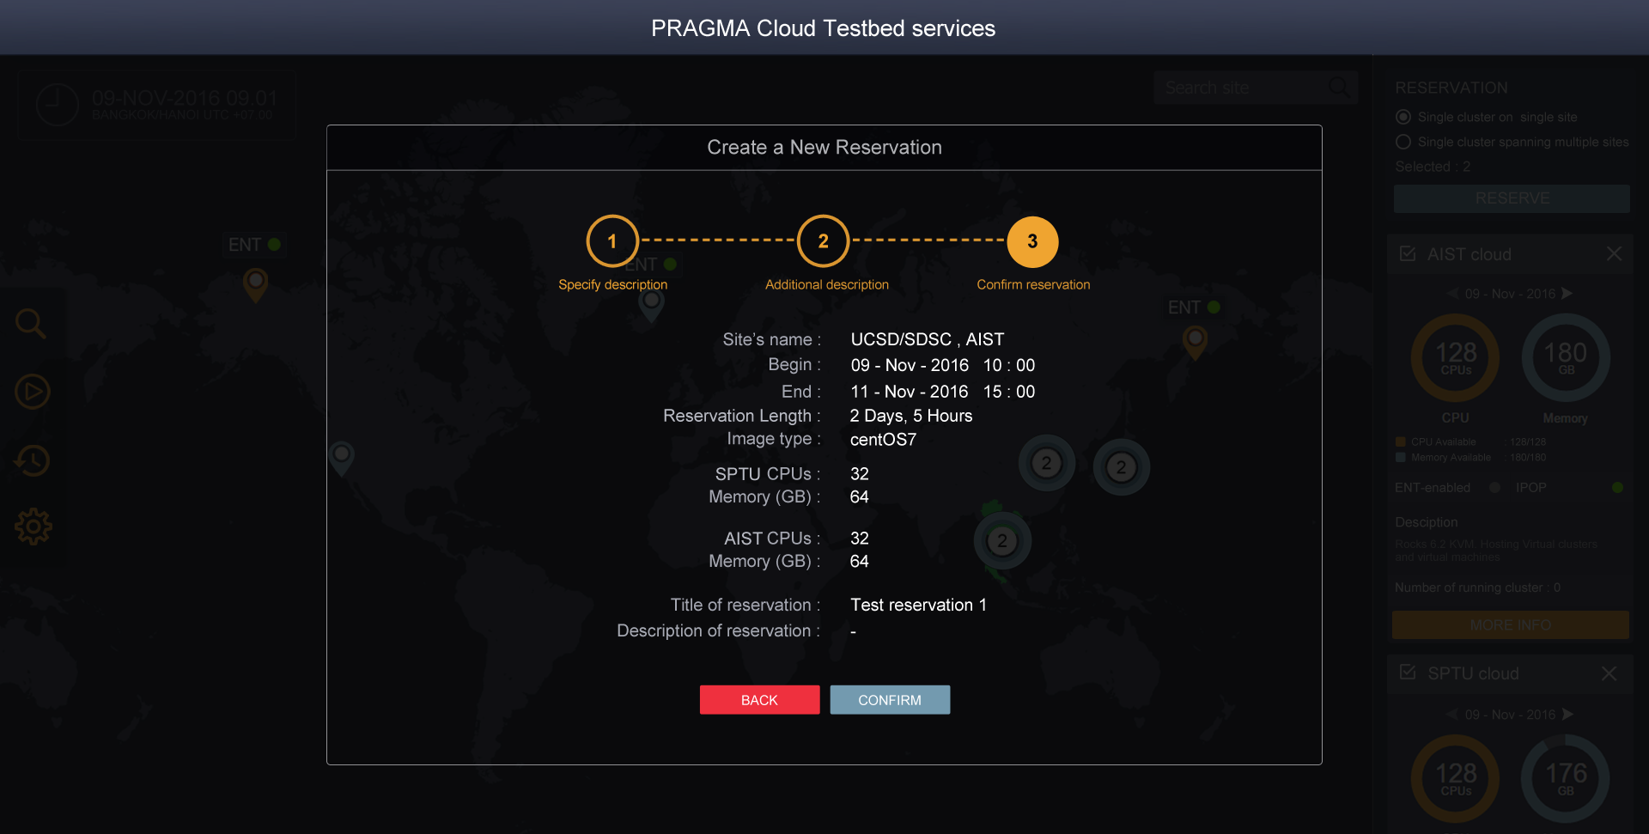
Notes:
Test

Slide 11
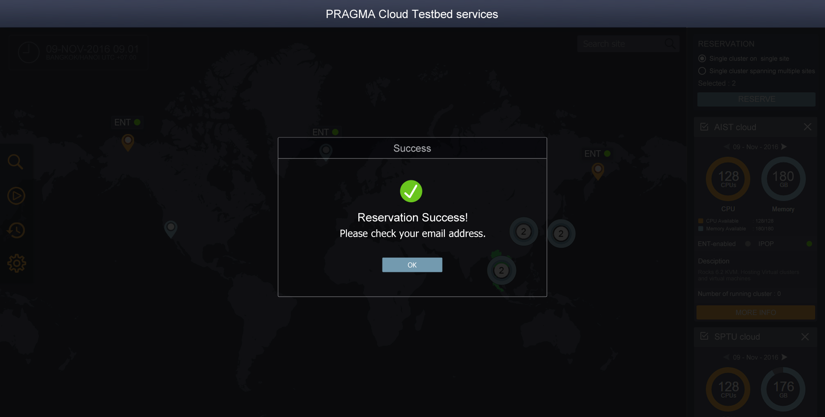
Notes:
Test

Slide 12

Notes:
Test

Slide 13
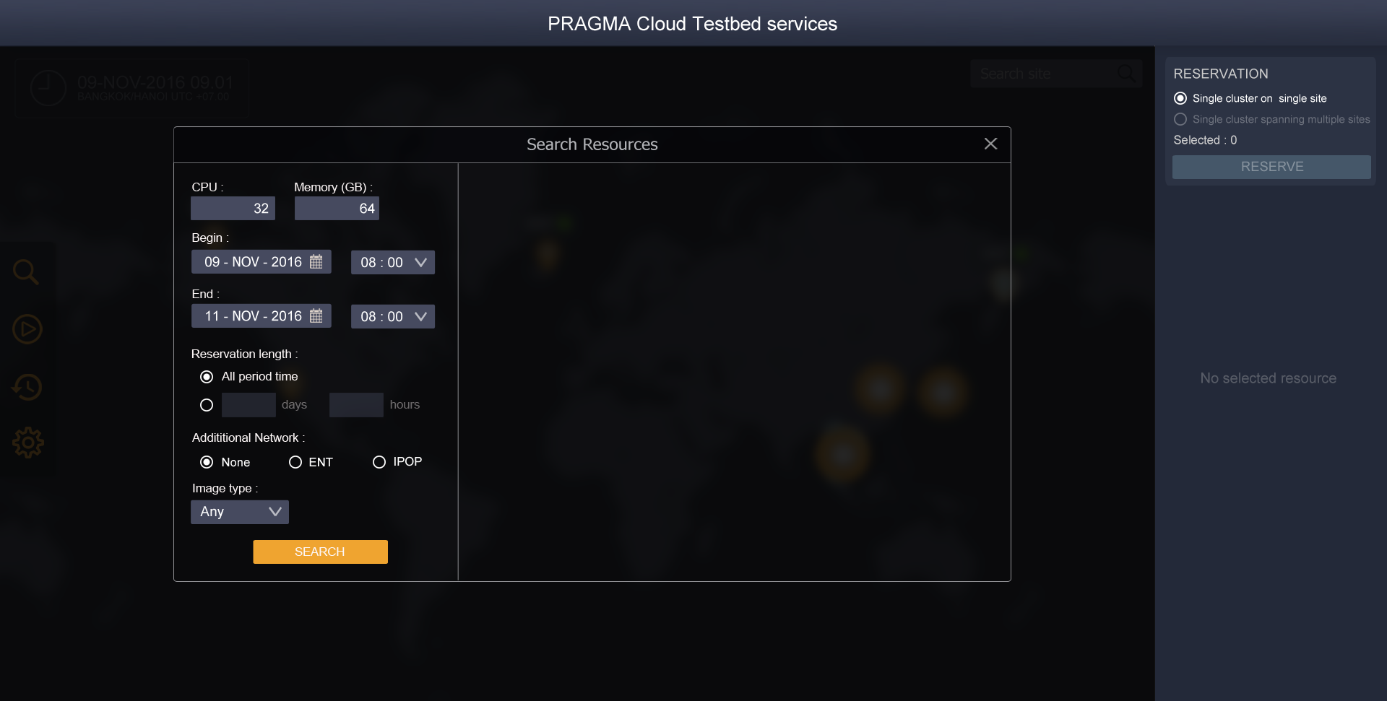
Notes:
Test

Slide 14
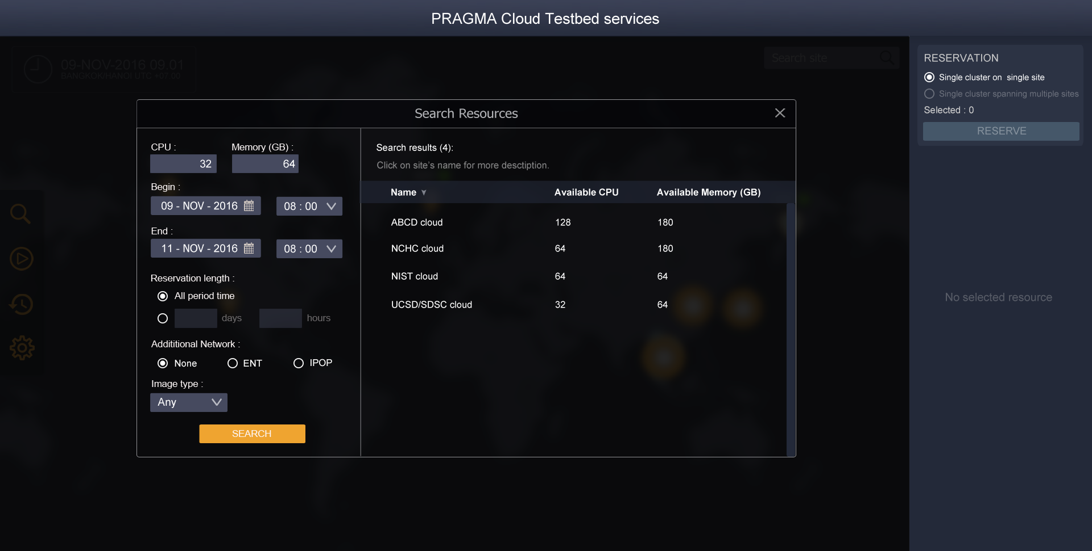
Notes:
Test

Slide 15
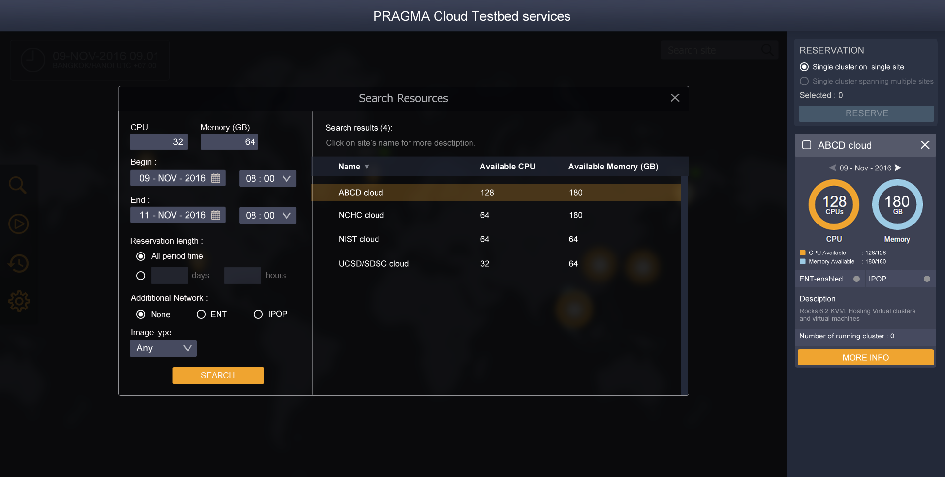
Notes:
Test

Slide 16
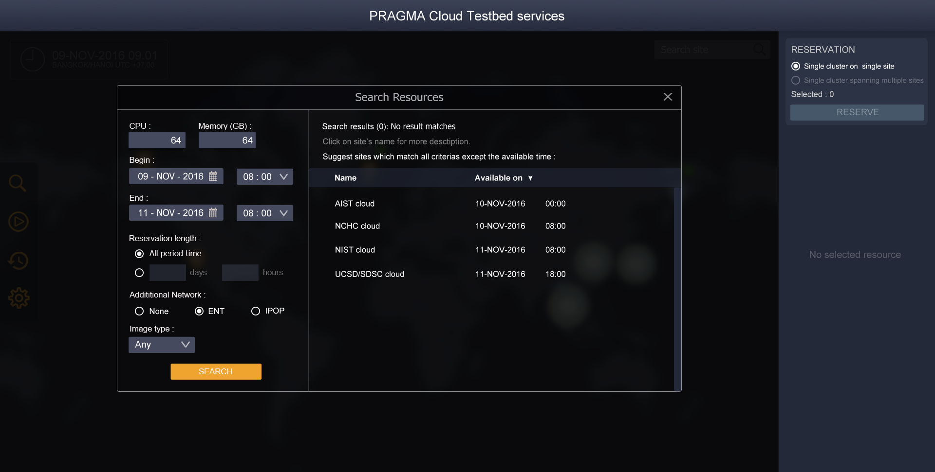
Notes:
Test

Slide 17
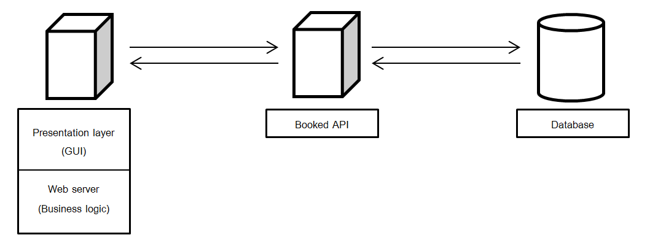
Architecture
Notes:
Test

Slide 18
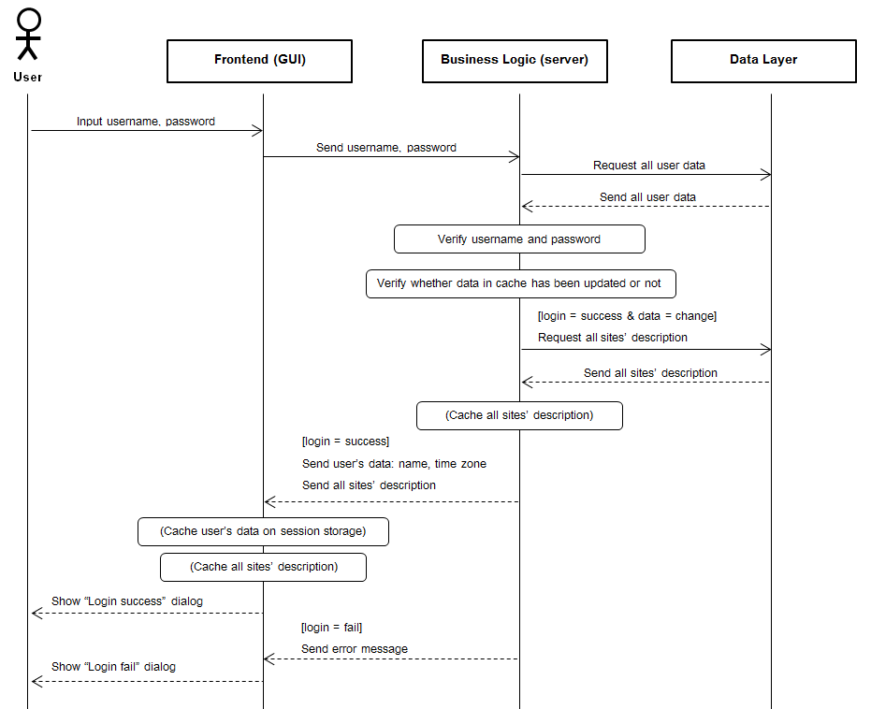
Sequence diagram - Login
Notes:
Test

Slide 19
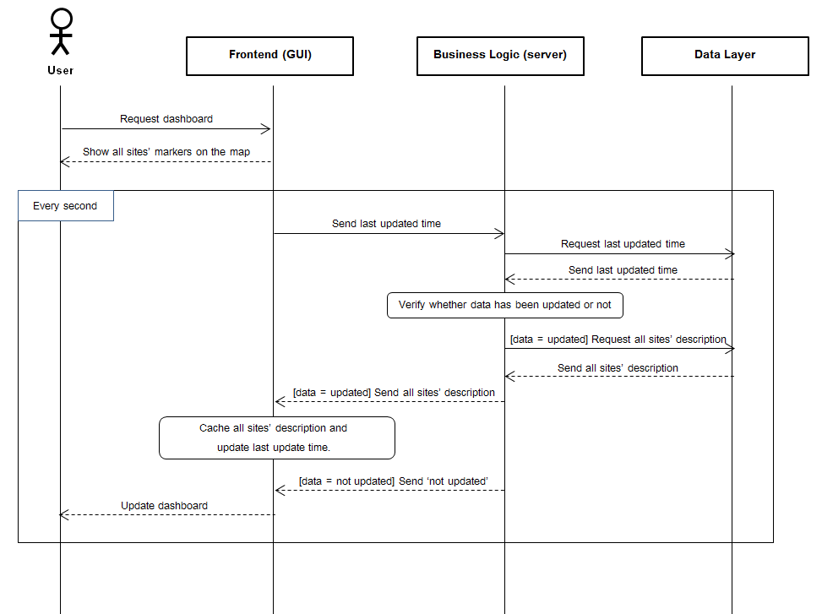
Sequence diagram - Dashboard
Notes:
Test

Slide 20
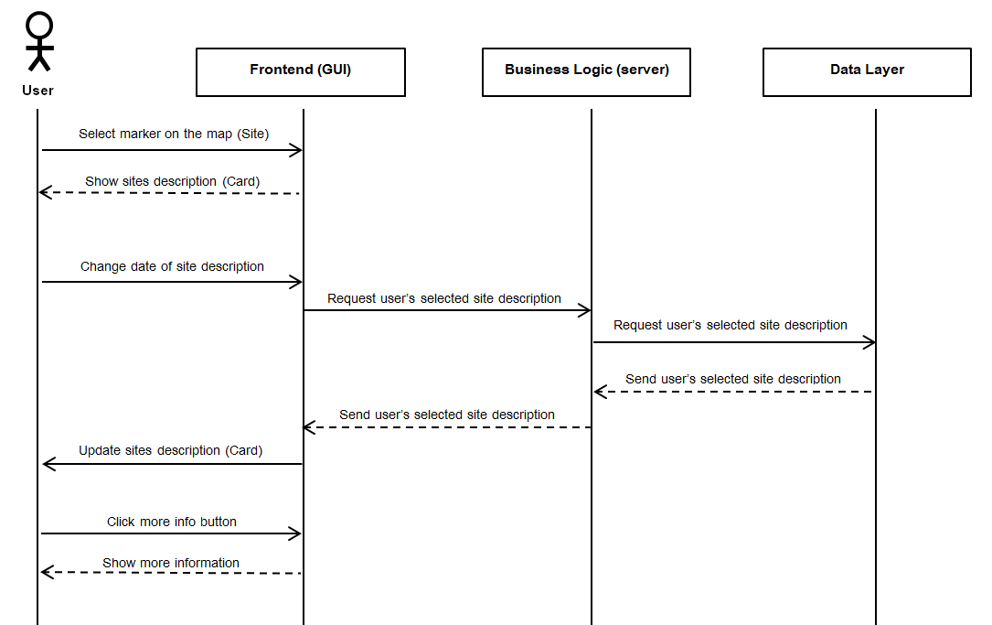
Sequence diagram - See site’s description
Notes:
Test

